Slide 1
Cryptography
See
Link to Essential Algorithms
The need for encryption in Khan Academy

Slide 2
Encryption is important
it allows you to securely protect data that you don't want anyone else to have access to
It may be data on your computer, usb key, smartphone etc
or the data you transfer when you email or do online banking or shopping
Many websites now use https instead of http
all data between your browser and the website is encrypted
Cyber attack on HSE in 2021:
https://www.hse.ie/eng/services/publications/conti-cyber-attack-on-the-hse-full-report.pdf

Slide 3
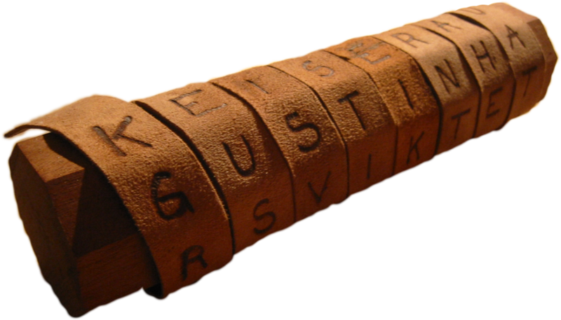
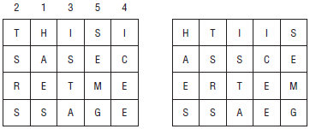

Historical Cryptography

Slide 4
Agenda
Terminology Ancient Cryptography
Transposition Ciphers Substitution Ciphers Public-Key Encryption

Slide 5
Terminology
Sender
Receiver
Attacker/adversary
Plaintext
Ciphertext
Key – used to encrypt/decrypt, unknown to attacker
Encrypting/enciphering
Decrypting/deciphering
Cryptanalysis – attacker’s study of methods to break the encryption

Slide 6

Ancient Cryptography
Writing (when few can read)
Nonstandard hieroglyphics
Scytale (rhymes with “Italy”)
These are “security through obscurity”
Notes:
https://en.wikipedia.org/wiki/Scytale
Leonardo di Vinci wrote most of his personal notes in mirror writing. This may not have been for security reasons (it’s not a very good code).

Slide 7
Formatting Messages
Punctuation and spaces are removed
Letters are capitalized
Mono-spaced font
Five-character groups
“This is a secret message!” becomes:
THISI SASEC RETME SSAGE
Notes:
Removing spaces and punctuation hides clues such as word length.
Formatting just makes things line up easier. It’s particularly useful if you’re encrypting or decrypting by hand.
Modern methods work with byte streams so they can encrypt punctuation, upper and lower case, bitmaps, audio, etc.

Slide 8
Transposition Ciphers
Sender:
Rearranges the plaintext letters to get the ciphertext
Receiver:
Undoes the rearrangement to recover the plaintext
Row/Column Substitution
Column Transposition
Route Ciphers

Slide 9
Row/Column Transposition
Sender:
Write plaintext into a grid by rows
Read out ciphertext by columns
Receiver:
To decipher piece of text
Original text was in array R rows and C columns
To decipher the encrypted text is the same as encrypting that text with an array that has C rows and R columns
Key gives the grid dimensions – number of columns is sufficient
Notes:
To decipher a message in a program, notice that decoding a message that
was originally written in an array that has R rows and C columns is the same
as encrypting a message with an array that has C rows and R columns.

Slide 10
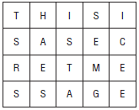
Example
Plaintext: THISI SASEC RETME SSAGE
Key: 4 x 5
Ciphertext: TSRSH AESIS TASEM GICEE

Slide 11
Cryptanalysis
Cryptanalysis is an attacker’s study of the methods for breaking an encryption.
For Row/column Transposition
the key is the number of columns
This has a limited set of values
Easy to break the encryption, especially if use a computer

Slide 12
Substitution Ciphers
Letters in the plaintext are replaced with other letters
Caesar Substitution
Simple Substitution
Vigenère Cipher
One-Time Pad

Slide 13
Caesar Substitution
Letters are shifted by some amount
About 2,100 years ago, Julius Caesar (100 BC–44 BC) used a shift of 3 (A → D, B → E, etc.)
Julius Caesar’s nephew Augustus used a shift of 1

Slide 14
Example
Plaintext: THISI SASEC RETME SSAGE
Key: 3
Ciphertext: WKLVL VDVHF UHWPH VVDJH

Slide 15
Cryptanalysis
Letter frequencies
Attacker can decipher message by examining frequencies of letters in the ciphertext
In English, E is the most frequently occurring letter
See textbook for more info

Slide 16
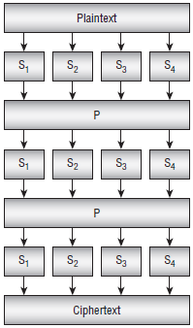
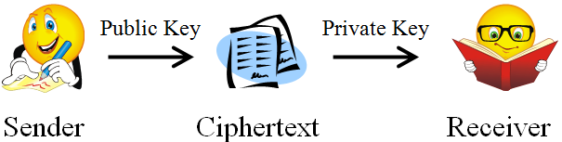
Modern Cryptography

Slide 17
Public-Key Encryption
The sender uses the public key (known to everyone) to encrypt messages
The receiver uses the private key (known only to the receiver) to decrypt messages

Slide 18
RSA
Uses the fact that multiplying two numbers is easy but factoring large numbers is hard
Notes:
RSA from initials of Ron Rivest, Adi Shamir, and Leonard Adleman at MIT

Slide 19
Generating Keys
Pick two large prime numbers p and q
Compute n = p×q. Release n as the public key modulus.
Compute φ(n), where φ is Euler’s totient function (more about this later). Pick integer e where 1 ≤ e ≤ φ(n) and e and φ(n) are relatively prime. Release n as the public key exponent.
Find d, the multiplicative inverse of e modulo φ(n). In other words, e×d ≡ 1 mod φ(n). The value d is the private key.
Notes:
The largest known prime number (as of November 2022) is 2^{82,589,933} − 1, a number which has 24,862,048 digits when written in base 10. It was found via a computer volunteered by Patrick Laroche of the Great Internet Mersenne Prime Search (GIMPS) in 2018 –
See https://en.wikipedia.org/wiki/Largest_known_prime_number#:~:text=The%20largest%20known%20prime%20number,Search%20(GIMPS)%20in%202018.

Slide 20
Encrypting and Decrypting
The public key consists of the values n and e
To encrypt message M, the sender uses the formula C = Me mod n
To decrypt a message, the receiver simply calculates C^{d} mod n

